Slide 1

SOFTWARE ENGINEERING And testing (BCAC 0027)

Slide 2
Module No. | Content | Teaching Hours
I | Introduction: Introduction to Software Engineering, Software characteristics, Software Crisis, Software Engineering Process. Software Development Life Cycle (SDLC) Models: Waterfall, Incremental, Iterative Enhancement, Prototype, RAD and Spiral Models. Software Requirements Engineering: Types of Requirements, Requirement Elicitation Techniques Like Interviews, FAST & QFD, Use case Approach, Requirements Analysis Using DFD, Data Dictionaries & ER Diagrams, Requirements Documentation, and SRS. Software Project Planning: Size Estimation like Lines of Code & Function Count, Cost. Estimation Models: COCOMO (Basic, Intermediate) Software Design: Cohesion & Coupling, Classification of Cohesion & Coupling, Function Oriented Design, Object Oriented Design, Structure chart. Coding: Characteristics of Coding and Coding style. | 20
II | Software Metrics: Software Measurements, Token Count, Halstead Software, Measures. Software Reliability & Quality: Introduction of Mc Call’s & Boehm’s Quality Model, Capability Maturity Models Software Reliability Models: Basic Execution Time Model. Software Testing: Testing Fundamentals: Test Case Design, Black Box Testing Strategies, White Box Testing, Unit Testing, Integration Testing, System Testing. Introduction to Automation Testing and Testing Tools: Automated Testing Process, Framework for Automation Testing, Introduction to Automation Testing Tool. Software Maintenance: Maintenance Process Maintenance models: Belady and Lehman Model, Boehm Model Regression Testing, Software Configuration Management; Implementation, Introduction to Reengineering and Reverse Engineering. Software Risk Management: Risk Identification and Risk Analysis | 20

Slide 3
Software reliability and quality

Slide 4
What is reliability in terms of software ?
Reliability in software is software that has no failure and works in a special time period with a special environment.
Hardware reliability is the probability of the absence of any hardware-related system malfunction for a given mission on the other hand software reliability is the probability that the software will provide a failure-free operation in a fixed environment for a fixed interval of time.

Slide 5
Failures and Faults
A fault is the defect in the program that, when executed under particular conditions, causes a failure.
The execution time for a program is the time that is actually spent by a processor in executing the instructions of that program. The second kind of time is calendar time. It is the familiar time that we normally experience.

Slide 6
Contd…
There are four general ways of characterizing failure occurrences in time:
time of failure,
time interval between failures,
cumulative failure experienced up to a given time,
failures experienced in a time interval.

Slide 7
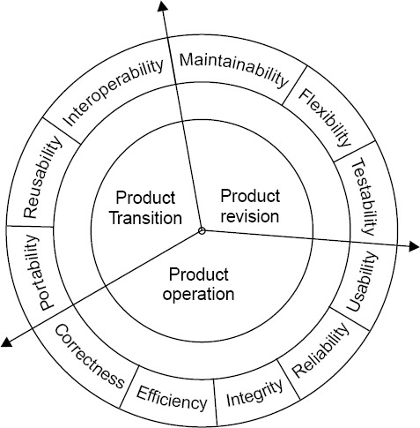
McCall Software Quality Model
How the software can be changed or improved
How the software works in different environments
How the software works in use
Fig. : Software quality factors

Slide 8
CONTD…
Product Operation (How the software works in use):
Product Operation includes five software quality factors, which are related to the requirements that directly affect the operation of the software such as operational performance, convenience, ease of usage, and correctness. These factors help in providing a better user experience.
2. Product Revision (How the software can be changed or improved):
Product Revision includes three software quality factors, which are required for testing and maintenance of the software. They provide ease of maintenance, flexibility, and testing efforts to support the software to be functional according to the needs and requirements of the user in the future.

Slide 9
CONTD…
3. Product Transition (How the software works in different environments):
Product Transition includes three software quality factors, that allow the software to adapt to the change of environments in the new platform or technology from the previous.
McCall’s model helps evaluate how well software performs, how easy it is to maintain, and how adaptable it is.
32

Slide 10
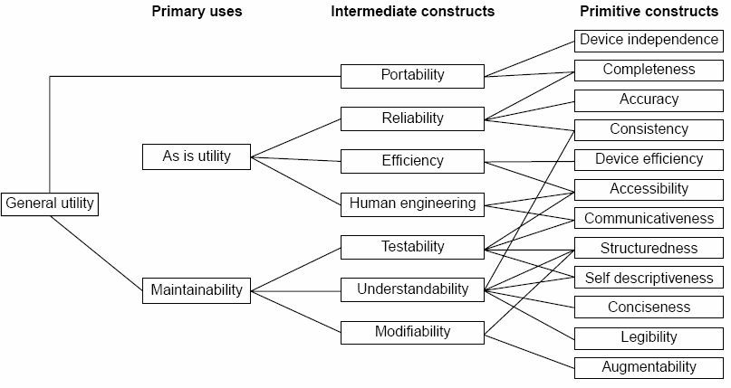
Boehm Software Quality Model
Fig. : The Boehm software quality model

Slide 11
In 1978, B.W. Boehm introduced his software quality model.
The model represents a hierarchical quality model similar to McCall Quality Model to define software quality using a predefined set of attributes (performance, reliability, or usability) and metrics
On the other hand, Boehm's quality model is based on a wider range of characteristics.
Example – Characteristics of hardware performance, that are missing in McCall’s model.

Slide 12
At the top level of Boehm's model, there are three primary uses:
As is utility - This tells us how much we can use the software as it is, meaning if we can use the software without making any changes or if there are any difficulties in using it without modifications.
Maintainability - This indicates how much effort it takes to fix an error detected during maintenance. It shows how hard we need to work to correct any problems that occur in the software.
Portability - This reveals how much effort is needed to fit the software into a new environment. It shows the complexity involved in shifting the software from one computer to another and how easily this can be done.

Slide 13
In the next level of Boehm's hierarchical model, there are seven quality factors related to three main uses:
Portability - This tells us how much effort it takes to adjust the software to work in a new environment. It checks the complexity involved in moving the software from one system to another.
Reliability - It measures how well the software performs according to its requirements.
Efficiency - This factor looks at the resources, like time and code, needed to perform a function. It checks how quickly and effectively the software completes tasks.
Usability (Human Engineering) - It measures how easy it is for users to learn, operate, and understand the software. It looks at whether the software is user-friendly or complicated.

Slide 14
5. Testability - It measures how much effort is needed to check if the software is working as it should. It examines the ease of verifying if the software meets its intended functions(specific task).
6. Understandability - It measures how much effort it takes for users to grasp the logical concepts behind the software and apply them.
7. Modifiability - It measures how much effort is needed to make changes to the software during the maintenance phase.

Slide 15
Capability Maturity Model
CMM was developed by the Software Engineering Institute (SEI) at Carnegie Mellon University in 1987.
It is a framework that is used to analyze the approach and techniques followed by any organization to develop software products.
It also provides guidelines to further enhance the maturity of the process used to develop those software products.
It is based on profound feedback and development practices adopted by the most successful organizations worldwide.
This model describes a strategy for software process improvement that should be followed by moving through 5 different levels.
Each level of maturity shows a process capability level. All the levels except level-1 are further described by Key Process Areas (KPA’s).

Slide 16
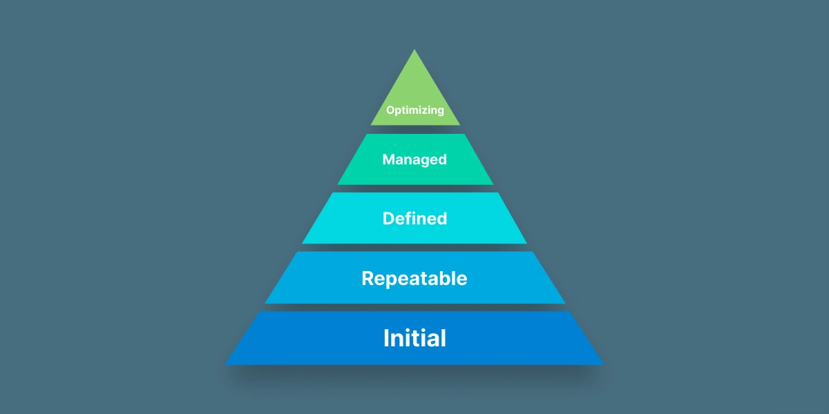
Capability Maturity Model
It is a strategy for improving the software process.
It is also used to developed organization software process.
The model describes a five level path .

Slide 17
Maturity Levels:
Initial (Maturity Level 1)
Repeatable (Maturity Level 2)
Defined (Maturity Level 3)
Managed (Maturity Level 4)
Optimizing (Maturity Level 5)

Slide 18
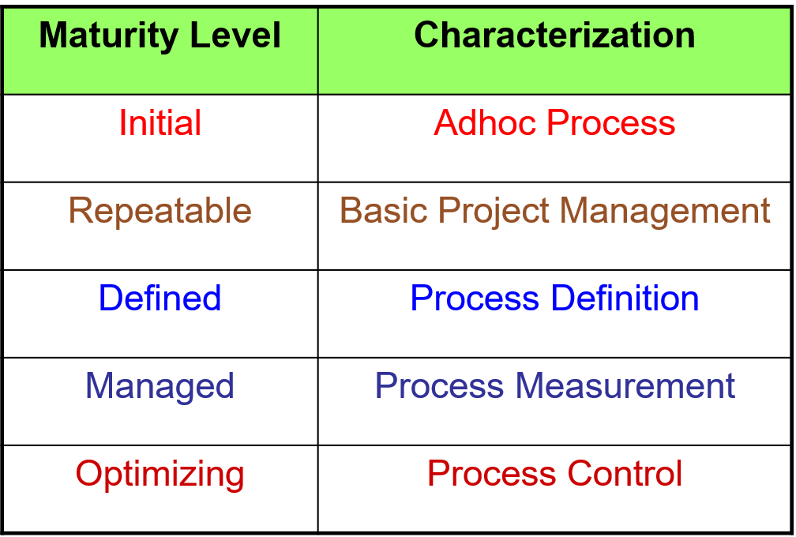
Fig. : The five levels of CMM

Slide 19
Level-1 Initial (Chaotic, ad-hoc)
The software process is characterized as inconsistent, and occasionally even chaotic. Defined processes and standard practices that exist are abandoned during a crisis. Success of the organization majorly depends on an individual effort, talent, and heroics. The heroes eventually move on to other organizations taking their wealth of knowledge or lessons learnt with them.

Slide 20
Level-2: Repeatable (Project management)
The software process is characterized as inconsistent, and occasionally even chaotic. Defined processes and standard practices that exist are abandoned during a crisis. Success of the organization majorly depends on an individual effort, talent, and heroics. The heroes eventually move on to other organizations taking their wealth of knowledge or lessons learnt with them.

Slide 21
Level-3: Defined (Standardized processes)
The software process for both management and engineering activities are documented, standardized, and integrated into a standard software process for the entire organization and all projects across the organization use an approved, tailored version of the organization's standard software process for developing,testing and maintaining the application.

Slide 22
Level-4: Managed (Quantitative management)
Management can effectively control the software development effort using precise measurements. At this level, organization set a quantitative quality goal for both software process and software maintenance. At this maturity level, the performance of processes is controlled using statistical and other quantitative techniques, and is quantitatively predictable.

Slide 23
Level-5: Optimizing (Continuous improvement)
The Key characteristic of this level is focusing on continually improving process performance through both incremental and innovative technological improvements. At this level, changes to the process are to improve the process performance and at the same time maintaining statistical probability to achieve the established quantitative process-improvement objectives.

Slide 24
E-books
Software Engineering- A Practitioner’s Approach by Roger S. Pressman
Software Engineering Ninth Edition by Ian Sommerville
Software Engineering Third Edition by K.K Aggarwal & Yogesh Singh

